Slide 1

Cef 440: internet programming (j2ee) and mobile programming
PROJECT TITLE:
DESIGN AND IMPLEMENTATION OF A MARKET
MANAGEMENT SYSTEM
TASK 3: UI DESIGN AND IMPLEMENTATION

Slide 2
Group members
GAMUAH PADJINOU RYANE JOY FE20A044
NDALEGH NOELA LUM MBAH FE20A070
FORMASIT CHIJOH FOKUNANG FE20A041
RACHEAL NKONGHO TAFONGOH FE20A100
MOSONGO ADINA SAKWE NANGERI FE20A066

Slide 3

TABLE OF CONTENTS
INTRODUCTION
DESCRIPTION
IMPORTANCE
TOOLS AND FRAMEWORKS
UI DIAGRAMS: VENDOR VIEW
REGISTER
LOG IN
ADD PRODUCTS
HOMEPAGE
UPDATE PRODUCTS
UI DIAGRAMS: BUYER VIEW
HOMEPAGE
PRODUCT RETURN PAGE
LOCATION
SHOP DETAILS

Slide 4
introduction
UI Design is the process designers use to build interfaces in software or computerized devices, focusing on looks or style.
UI design has a major role in making sure that interfaces help us achieve our goals with ease and enjoyment. For the users, UI designers ensure the visual design of an app or website is pleasing and intuitive to navigate.
Importance of UI design
User interface design can make a difference in a product’s emotional appeal. Done right, UI design can pique your user’s interest and get them excited about exploring the product more.
Quality UI design is the top reason why a website enjoys high traffic.

Slide 5


introduction
Tools and frameworks
For the design of the different application interfaces, Figma tool was used.
For the implementation of the different application interfaces, ReactNative framework was used.

Slide 6
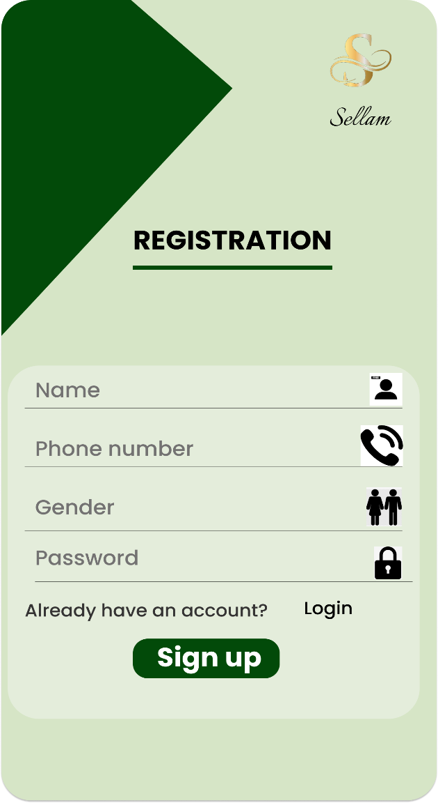
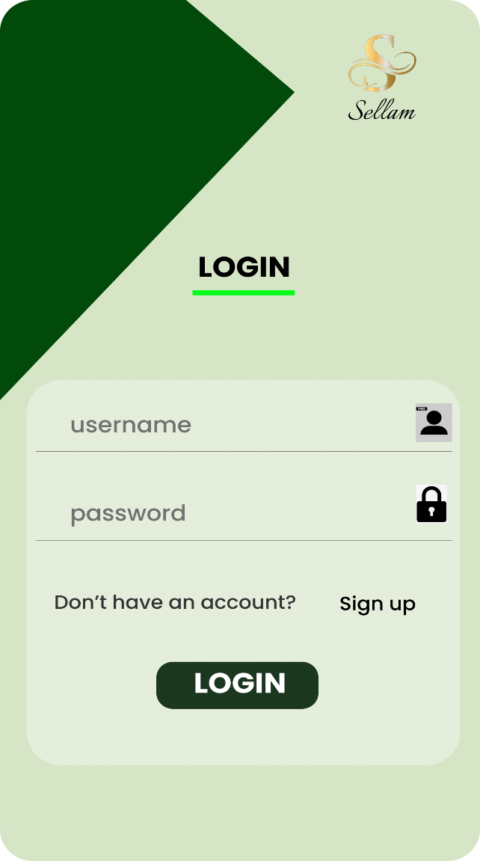
Ui diagrams: vendor view
register
Log in
This page enables vendor registration unto the platform
This page enables vendor logging into the platform

Slide 7
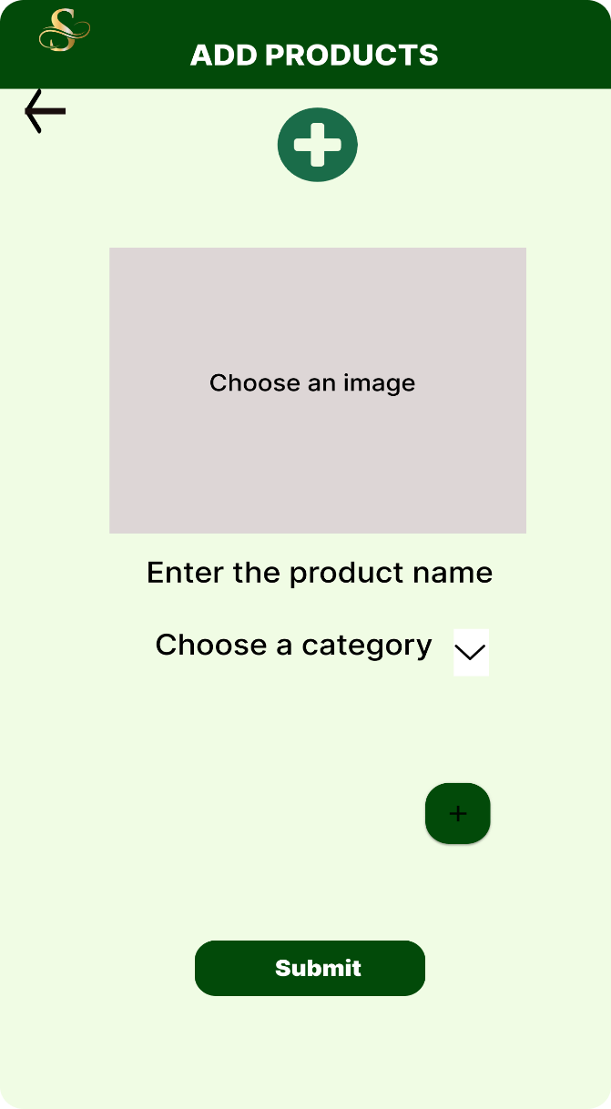
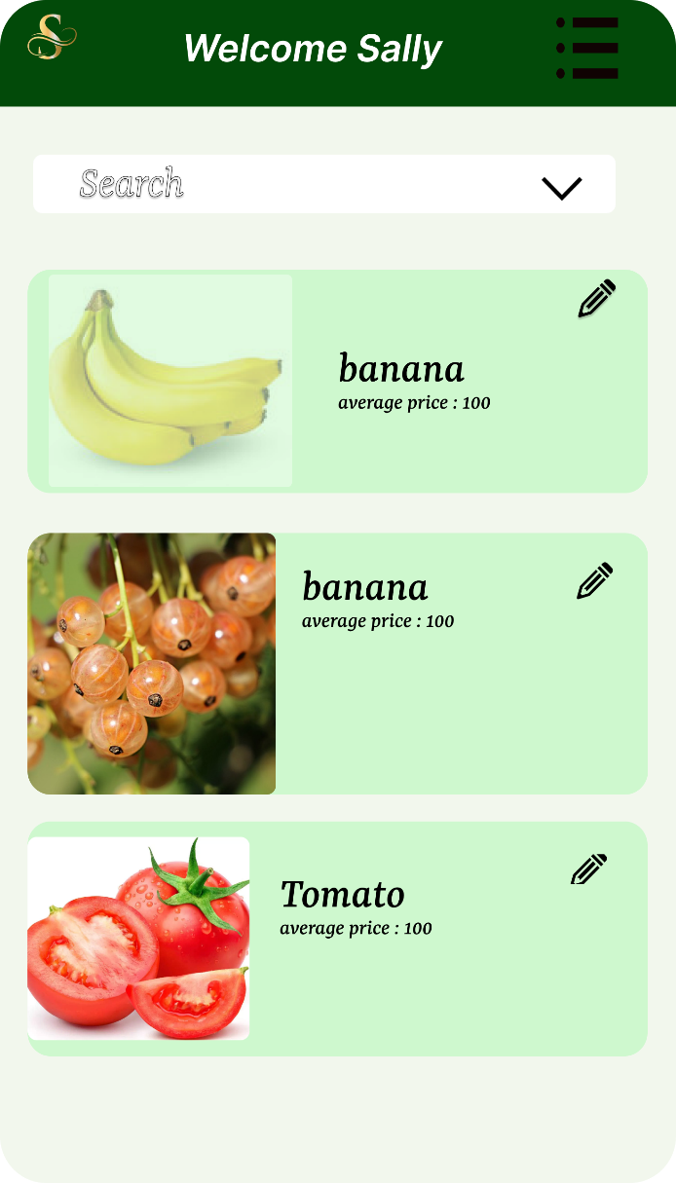
Add products
homepage
This page is the interface for aiding vendors add products to their store product list.
Here is the landing page, where a vendors view all their products and also view products available in the markets. Special product search is also possible as is shown.

Slide 8
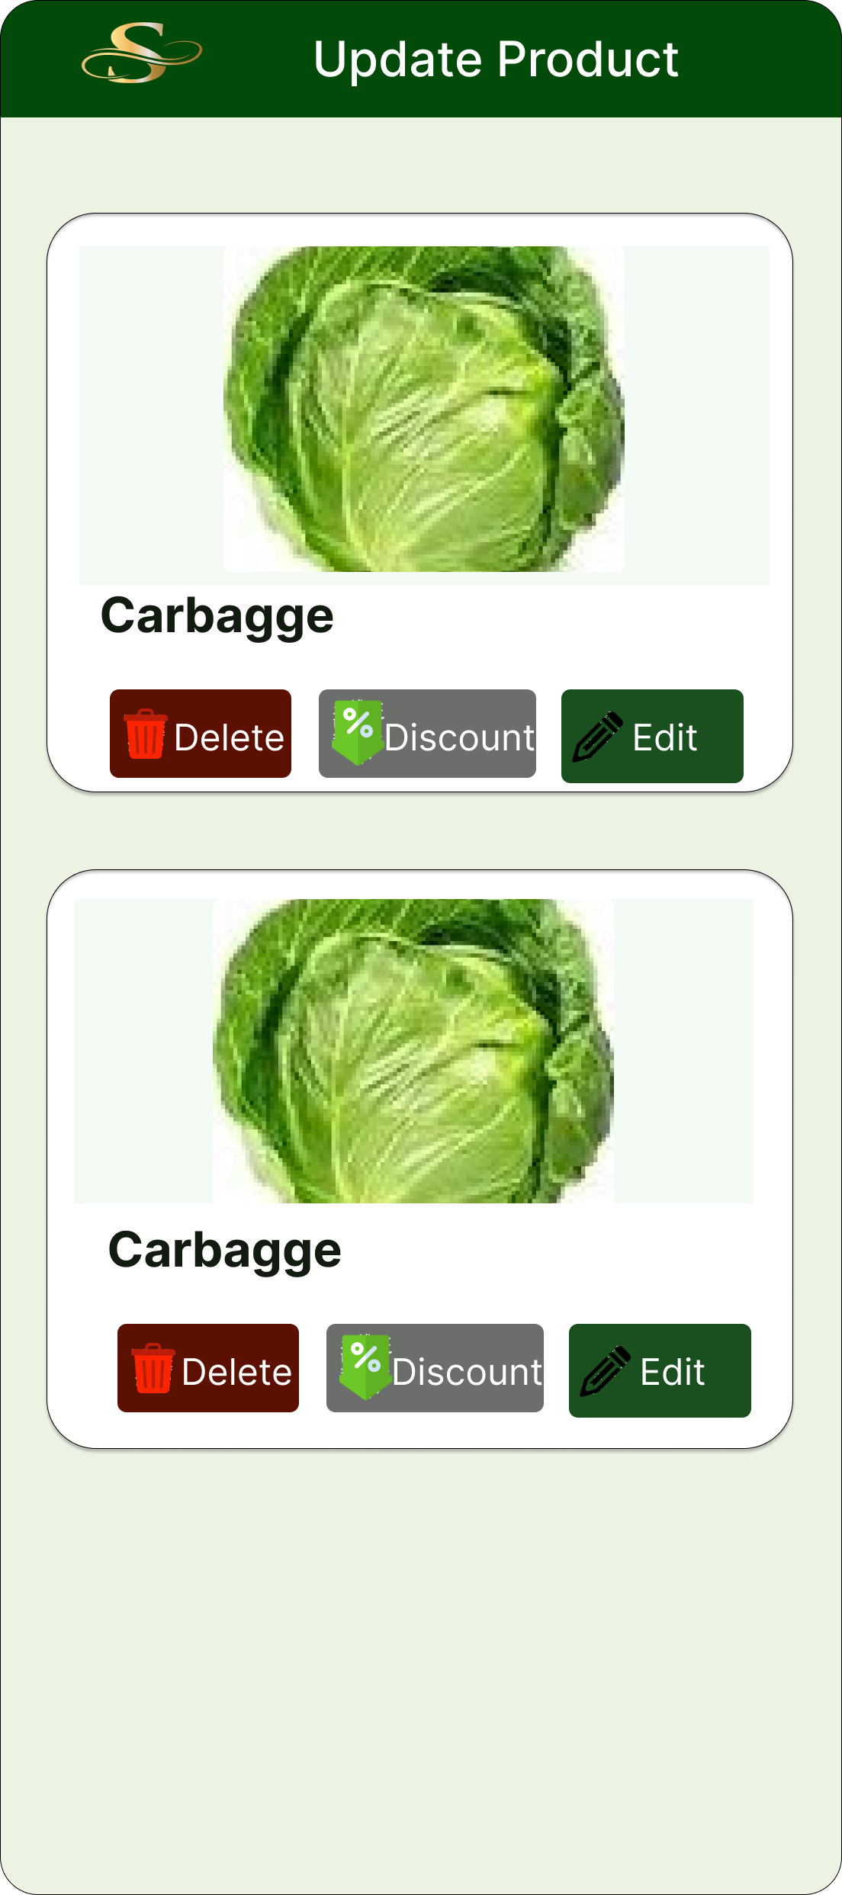
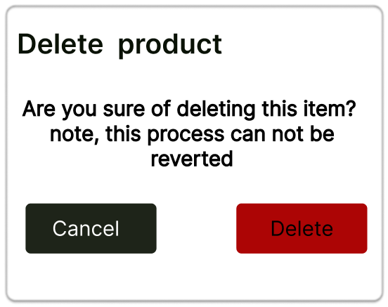
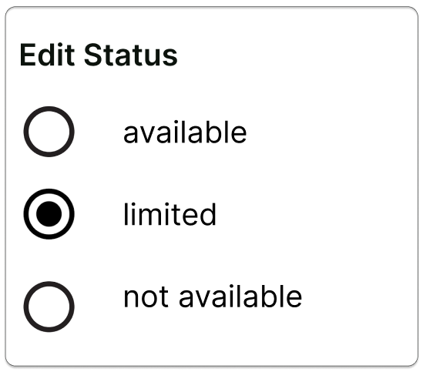
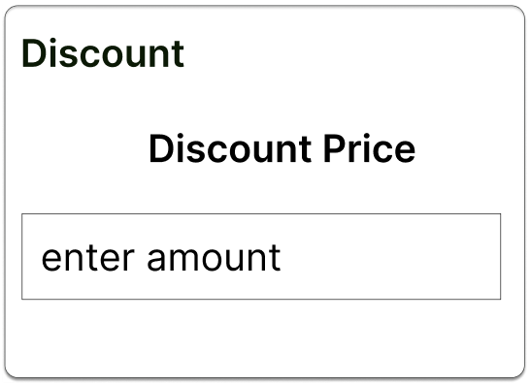
Update product
Delete product confirmation
Stock states
Discount setting
This page allows users either delete products, discount product prices or edit their stock status

Slide 9

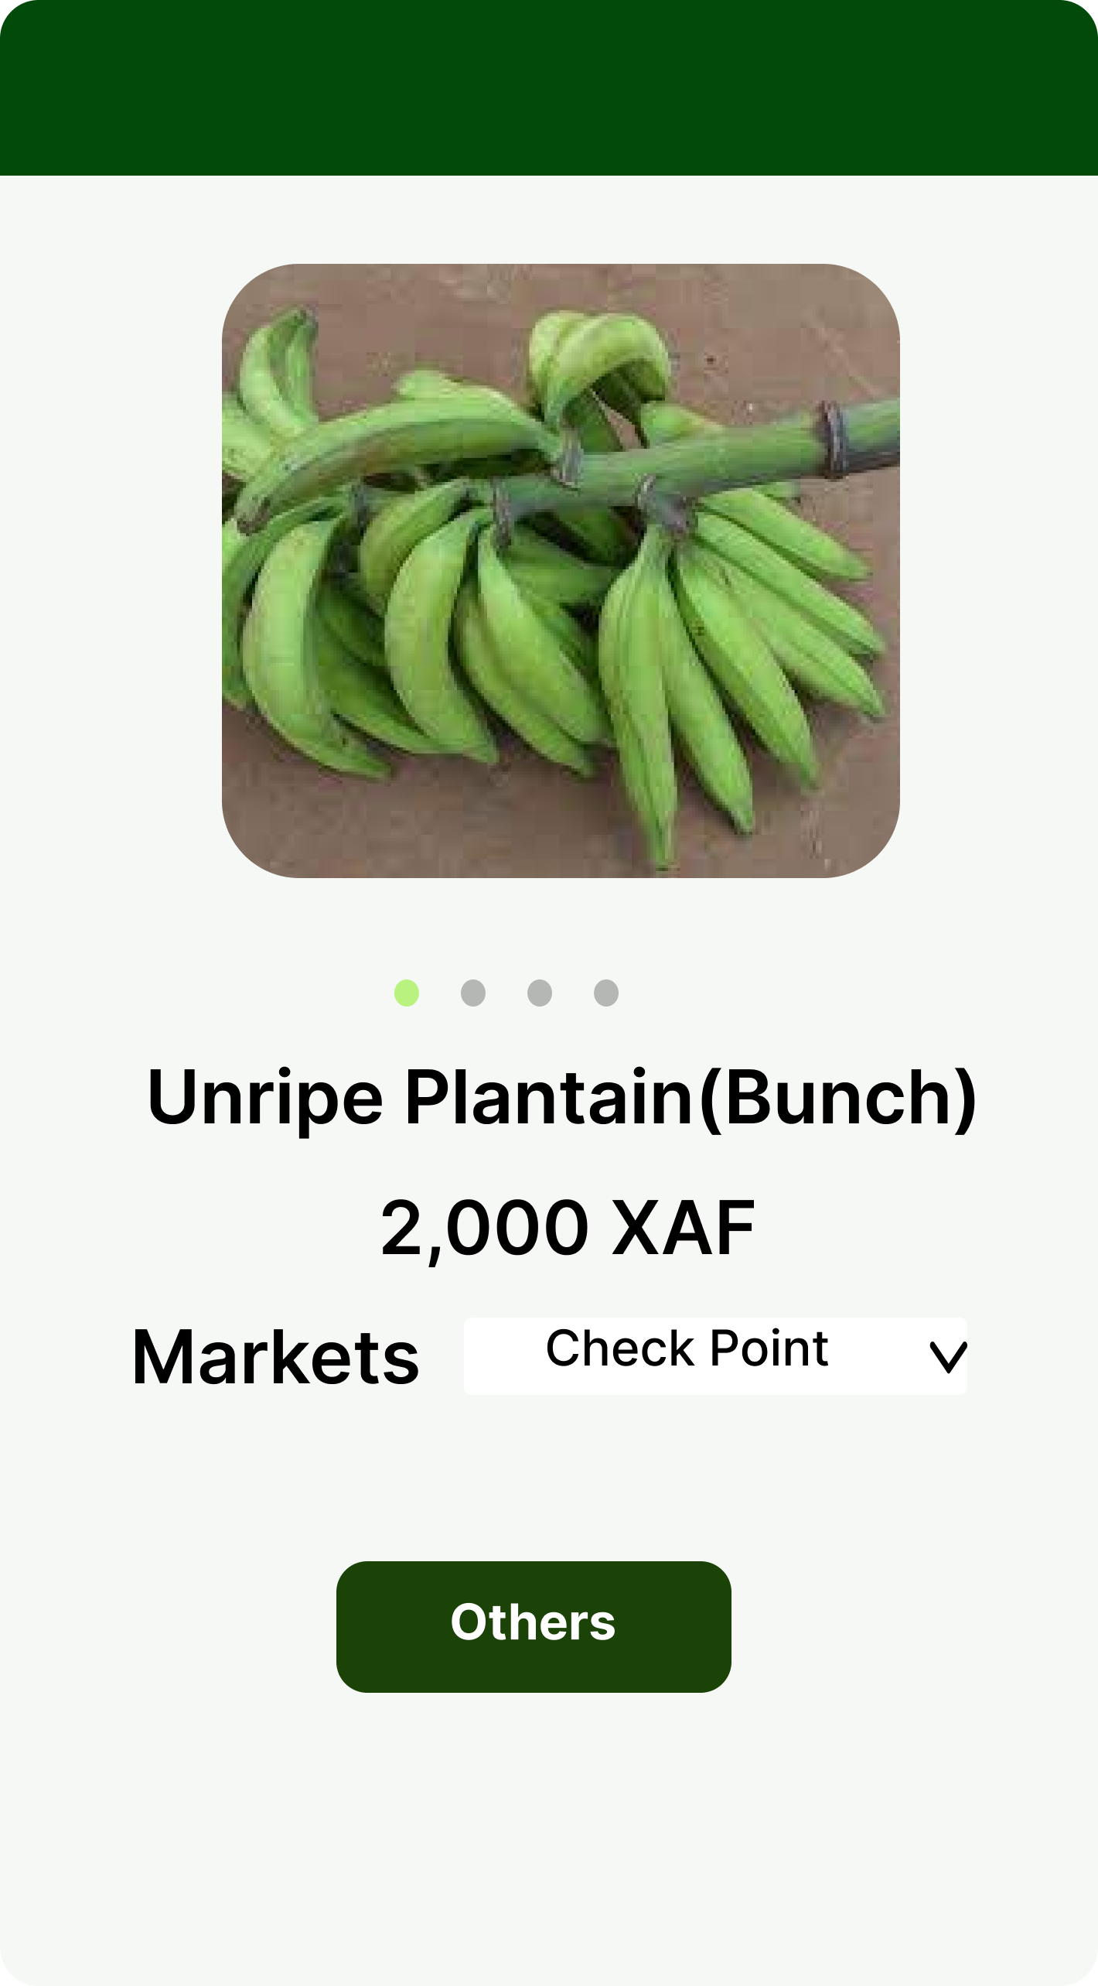
Ui diagrams: buyer view
homepage
Product return page
Here is the landing page, where a buyers view all products available in the markets. Special product search is also possible as is shown.
This proceeding page returns the market details of a product after successful search or selection.

Slide 10
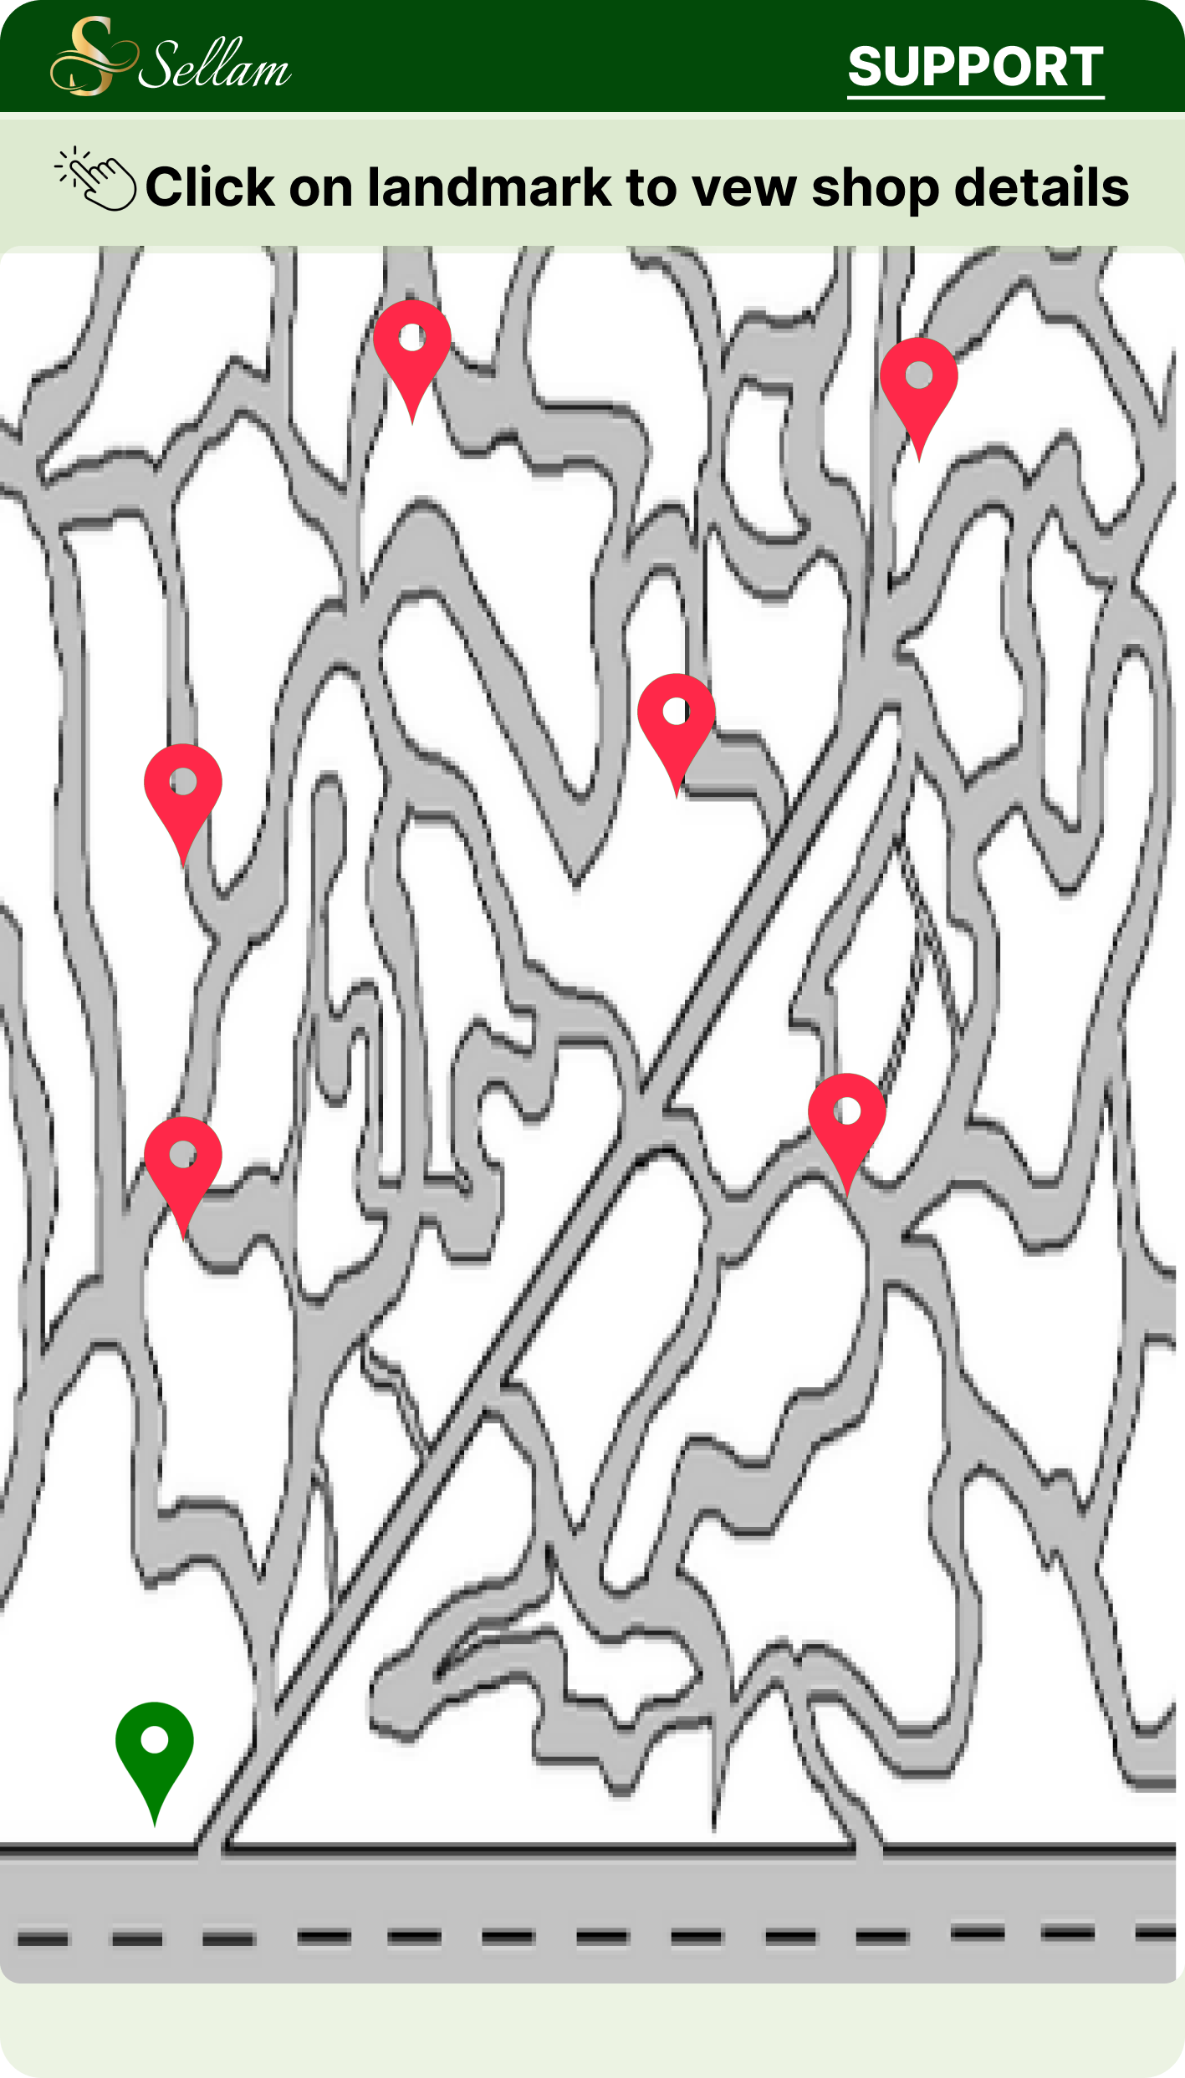
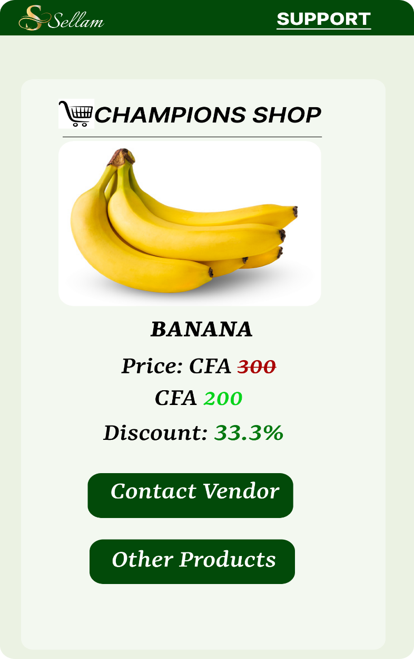
location
Shop details
On this page is displayed the different locations of stores selling a particular product in a market specified in the preceding page.
For a particular shop selected before, its specific product details and other features are displayed

Slide 11


